Slide 1
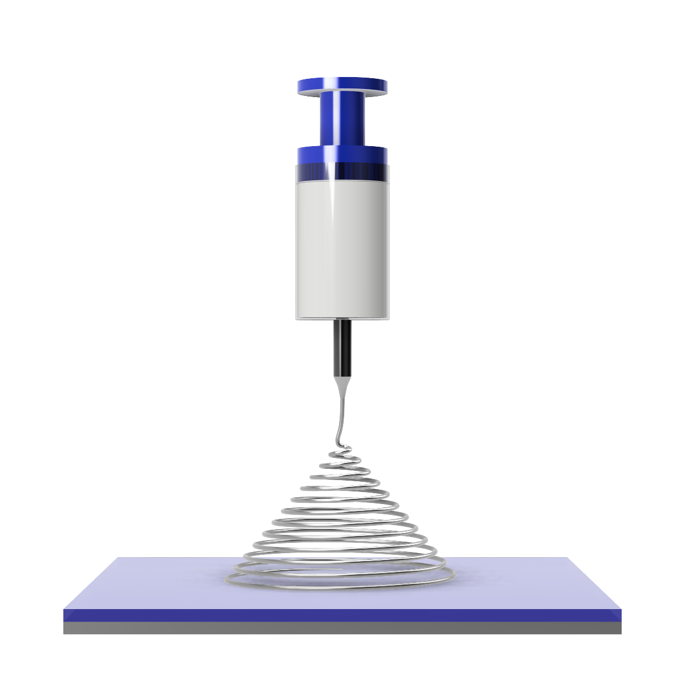
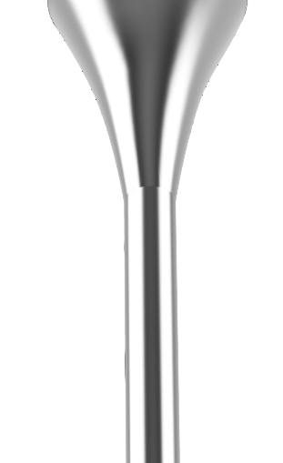
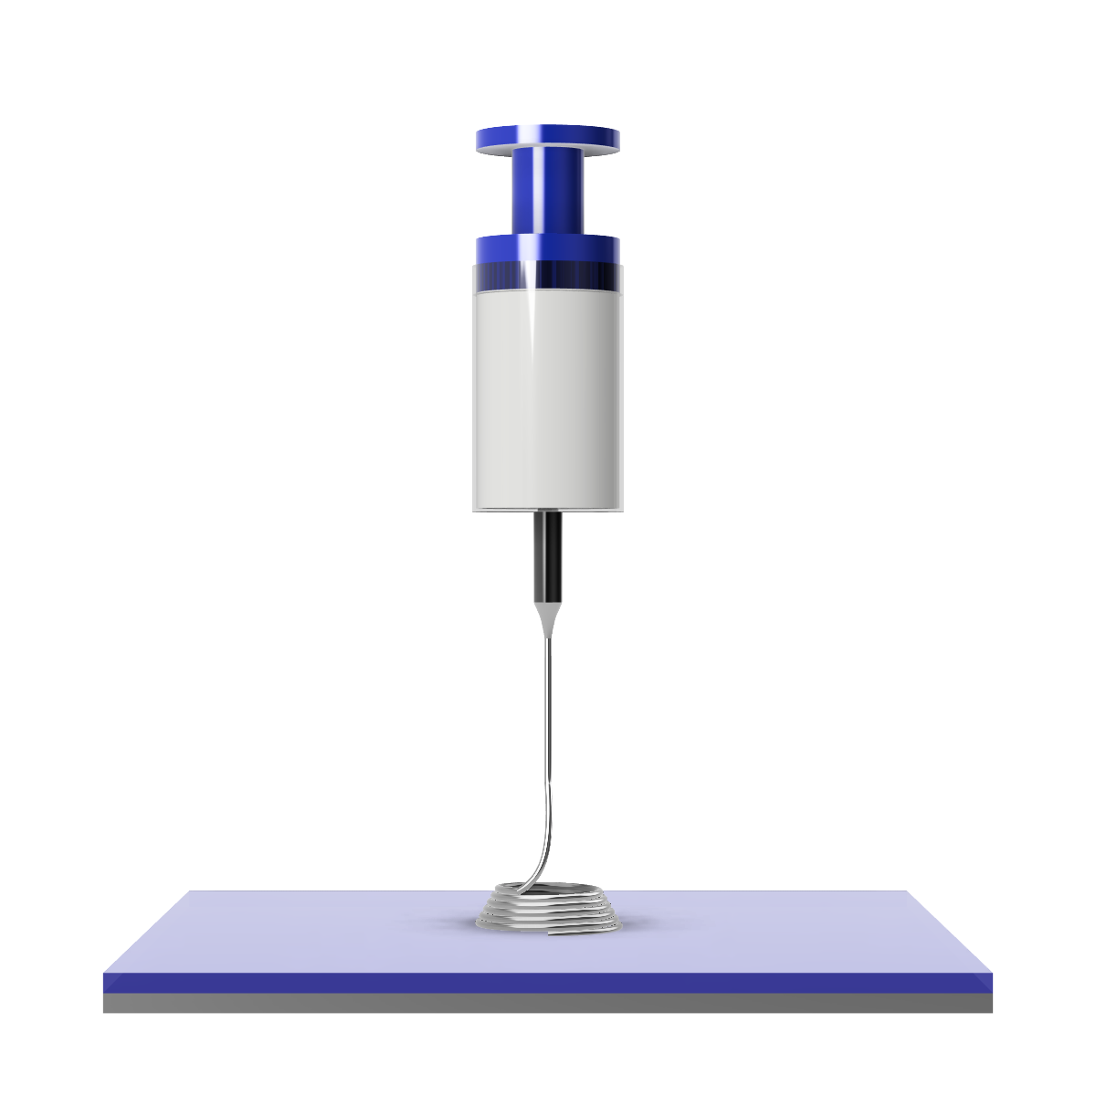

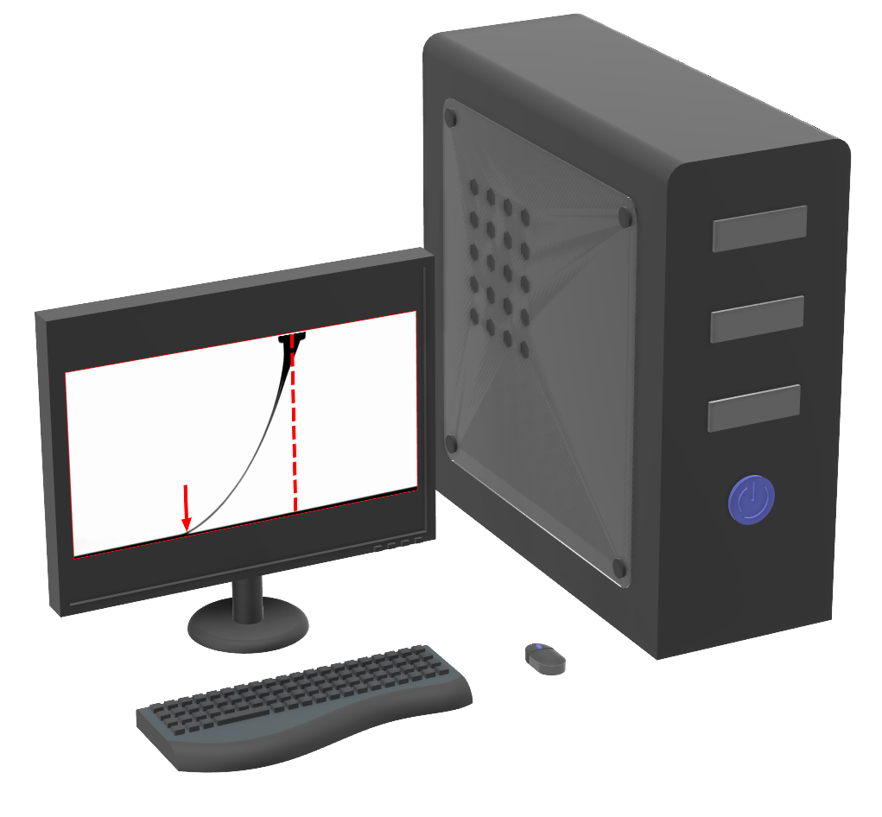
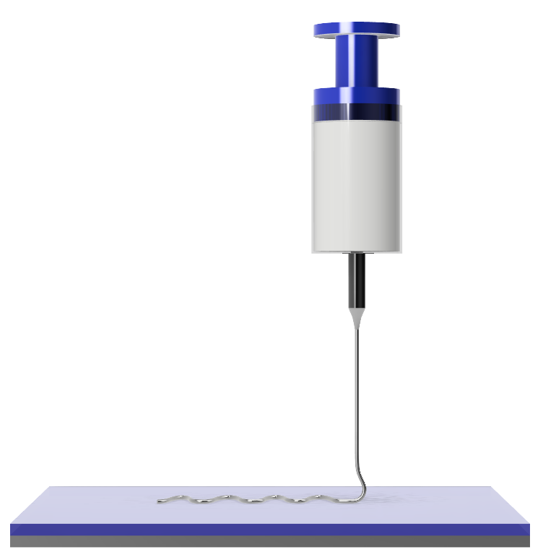


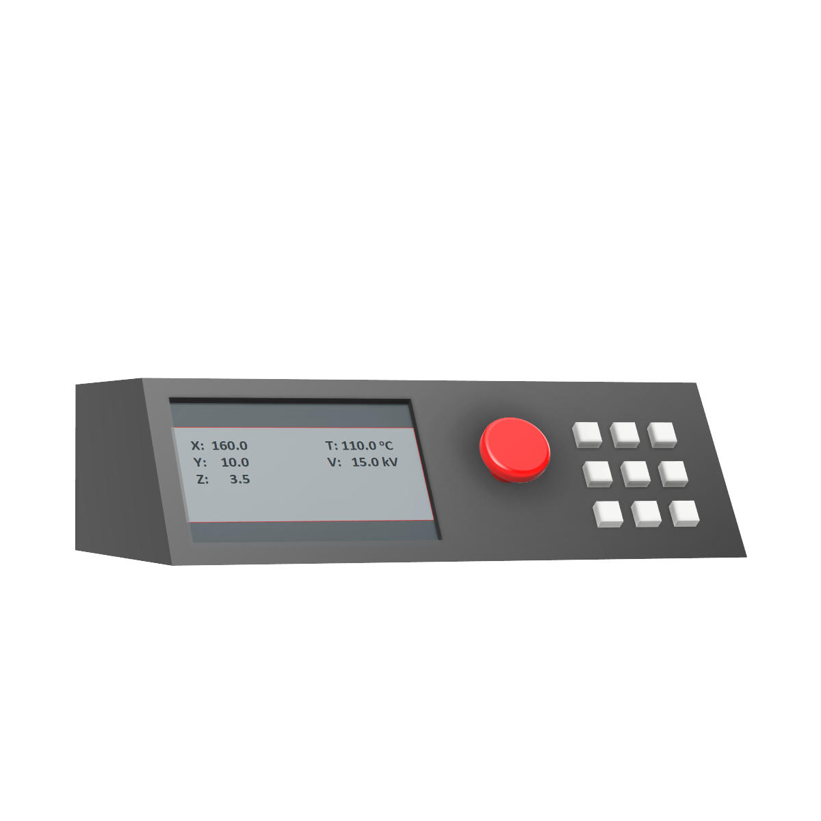
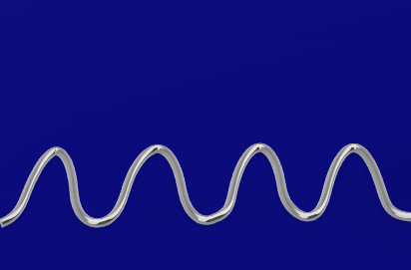
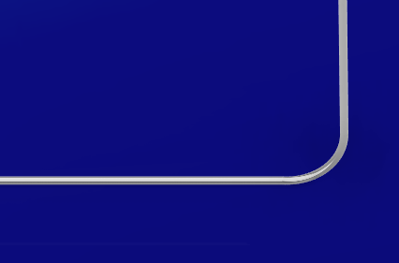
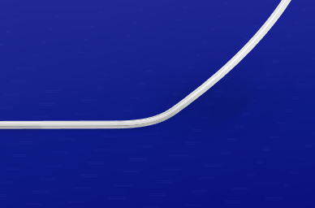
Straight Jet Regime
(a)
Polymer Solution
Polymer Melt
+
+
+
+
Evaporation
Cooling
Chaotic Collector Regime
Free Flow Regime
Stationary Collector
Stationary Collector
(b)
+
+
+
+
+
+
Collector Regime
Ucr > Uc > 0 mm/s
Uc > Ucr
Uc >> Ucr

